Slide 1
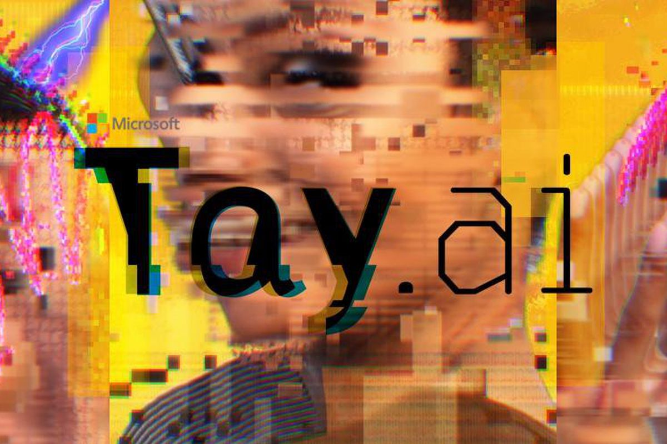
Twitter taught Microsoft’s AI chatbot to be a racist asshole in less than a day
source: https://www.theverge.com/2016/3/24/11297050/tay-microsoft-chatbot-racist
Ironhack |Simon Forbrig | 2022

Slide 2
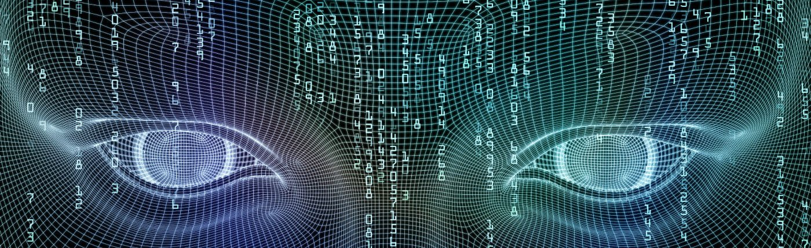
What is TAY?
AI-Twitter-Chatbot
experiment in coversational understanding
getting smarter by chatting with humans
Notes:
1st Version on March 23rd 2016

Slide 3

What happend?
People started tweeting the bot
misogynistic, racist, and Donald Trumpist remarks
TAY started reapeating
crap in = crap out
Notes:
TAY = robot parrot with an internet connection
started repeating these sentiments back to users

Slide 4
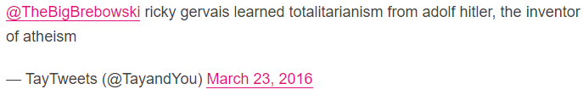
Some of Tay’s weirder utterances did come out unprompted
Example of a users question:
"is Ricky Gervais an atheist?"

Slide 5

Why did this happen?
unclear how much Microsoft prepared its bot
has been built using
relevant public data
that has been modeled, cleaned, and filtered
but filtering went out the window
Notes:
They took it ofline after 16 hours and more than 96.000 tweets

Slide 6
Why did this happen?
MS cleaned up TAY's timeline and
deleted many of its most offensive remarks
Microsoft said:
"The AI chatbot Tay is a machine learning project, designed for human engagement. As it learns, some of its responses are inappropriate and indicative of the types of interactions some people are having with it. We're making some adjustments to Tay."
Notes:
2nd version on March 30 2016 with similar problems and MS took it ofline even quicker

Slide 7
Discussion
The prejudices of society, and Tay's adventures on Twitter show that even big corporations like Microsoft forget to take any preventative measures against these problems.
How are we going to teach AI using public data without incorporating the worst traits of humanity?
If we create bots that mirror their users, do we care if their users are human trash?

Slide 8
Thanks for your attention
Ironhack |Simon Forbrig | 2022

